Slide 1




Learning PlayWright (Java)
E2E Web Testing with Playwright(Java)
Pramod Dutta
SDET Manager
Wait, Extraction Value, Assertions & Navigation - Part 5

Slide 2
Agenda
Extract Attributes of Elements.
Assertion with PlayWright
Navigation Commands
Waits and Timeouts

Slide 3
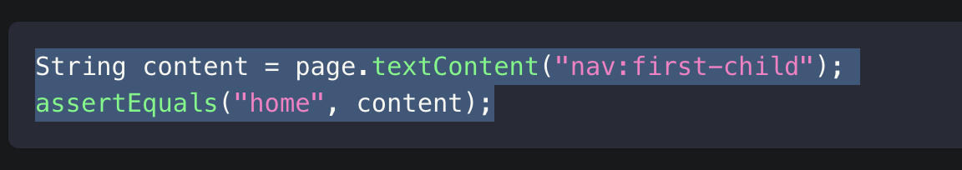
Lets Learn
Assertions
Text content
Inner text
String text = page.innerText(".selected");
Attribute value
String alt = page.getAttribute("input", "alt");
https://playwright.dev/java/docs/assertions

Slide 4
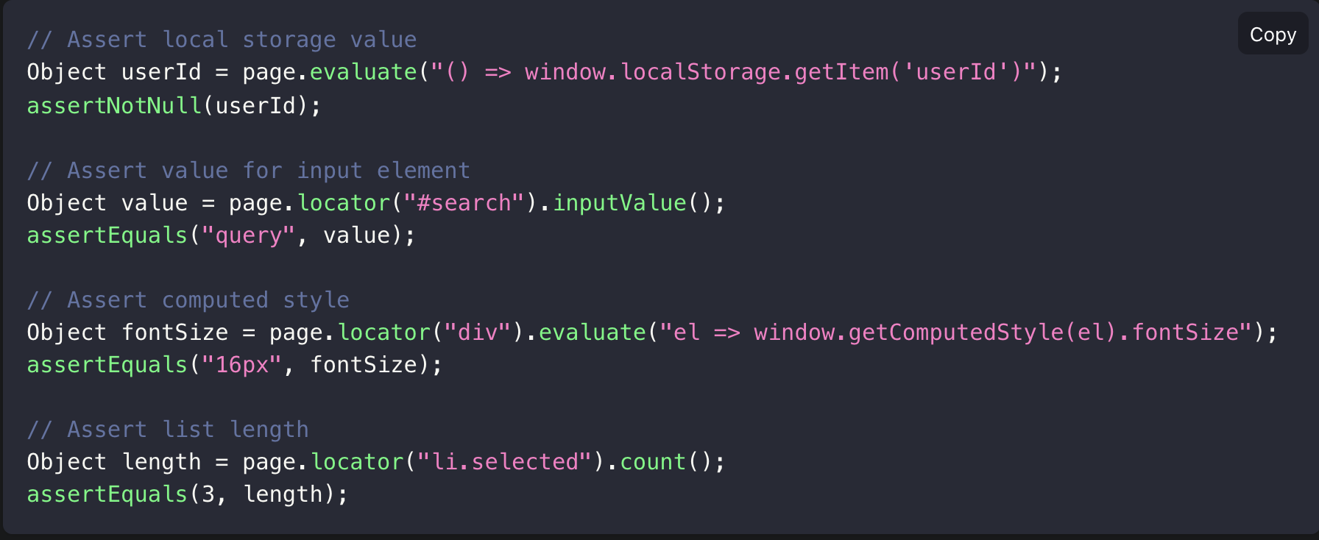
Lets Learn

Slide 5
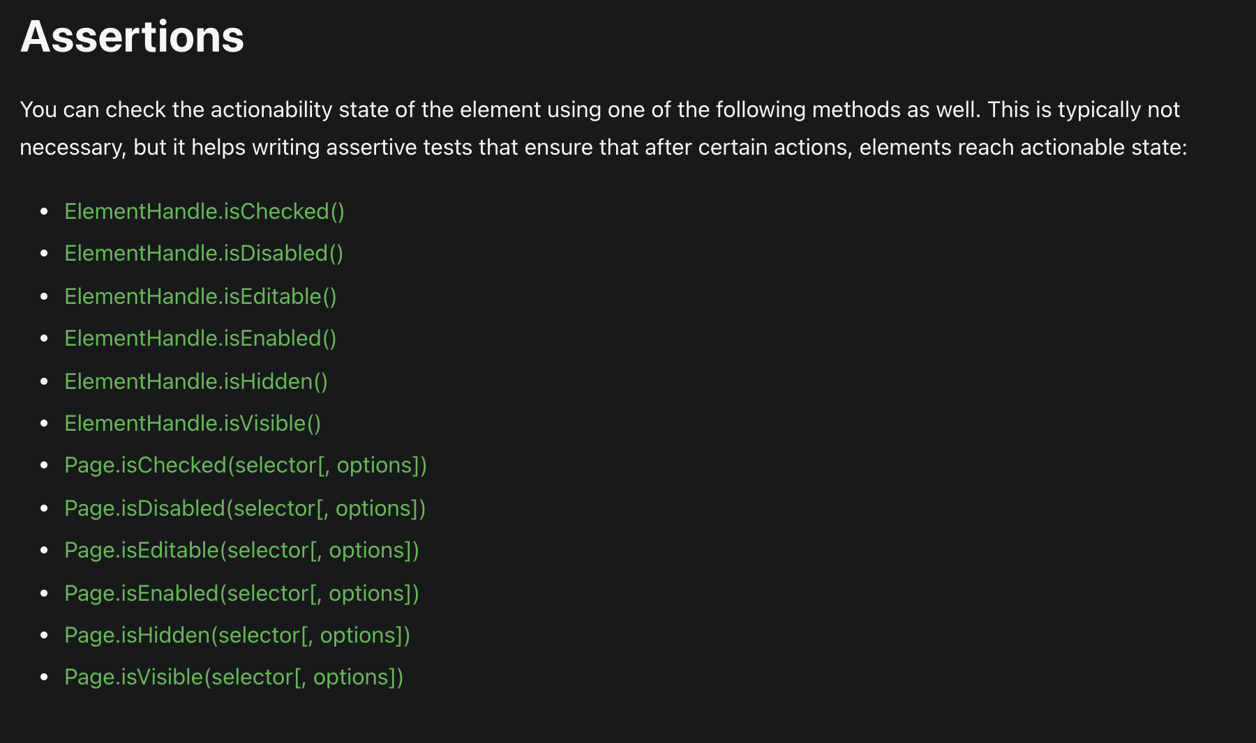
Lets Learn

Slide 6
Lets Learn
TestNG Assertions
Assert.methodName(actual, expected);
https://www.lambdatest.com/blog/asserts-in-testng/
Navigation
https://playwright.dev/java/docs/navigations
Page.navigate(url[, options])
// Navigate and wait until network is idle
page.navigate("https://example.com", new Page.NavigateOptions()
.setWaitUntil(WaitUntilState.NETWORKIDLE));
// Navigate and wait until network is idle
https://playwright.dev/java/docs/navigations#wait-for-element

Slide 7
Lets Learn
// Click will auto-wait for navigation to complete
// Fill will auto-wait for element on navigated page.
page.waitForLoadState(LoadState.NETWORKIDLE); // This resolves after "networkidle"
Many more.
https://playwright.dev/java/docs/navigations#wait-for-element

Slide 8
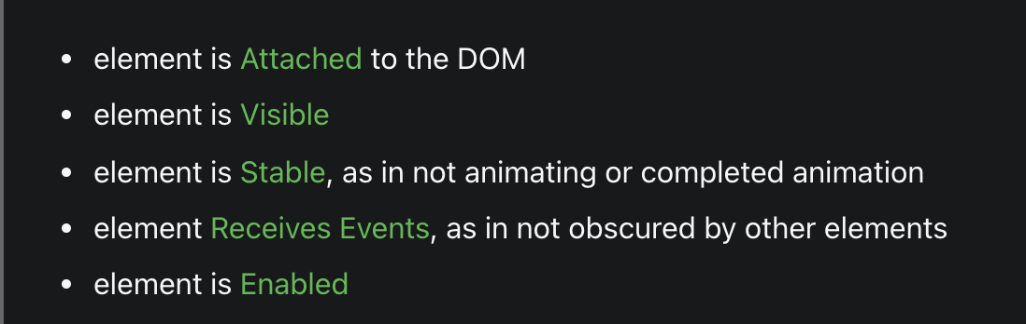
Lets Learn
WAIT And Timeout.
It auto-waits for all the relevant checks to pass.
E.g Page.click -> Wait for
page.waitForTimeout(5000); //Not Good, wait
page.waitForSelector(“div#content”);
page.setDefaultTimeout();
page.waitForEvent(‘event’);
page.waitForNavigation(){
page.click(“a”);
}

Slide 9
Playwright Demo.

